Slide 1


Inventory Management System
Muhammad Shayekur Rahman

Slide 2


Inventory Management System
Purpose: Manage Customer, Item and Order information in a database whilst being able add or delete items in an existing order.
Objective: Building Project in Java, implementing SQL, MAVEN AND TESTING.
Intended User: DATA ADMIN

Slide 3
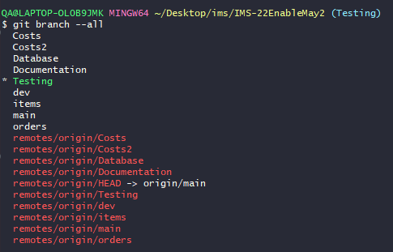
STAGE 0: USING VCS GIT AND FEATURE BRANCH MODEL
Using a forked repo, after cloning on to local remote, used a Dev branch and many features to implement correct approach.
Was especially key when adding Order Cost functionality,
Initially Created a new menu item in `Costs` which works
As intended, However, Used a new feature branch `Costs2`
To try a better alternative method, which proved to be better,
And eventually was merged with `dev`.

Slide 4
DOCUMENTATION
STAGE 1

Slide 5
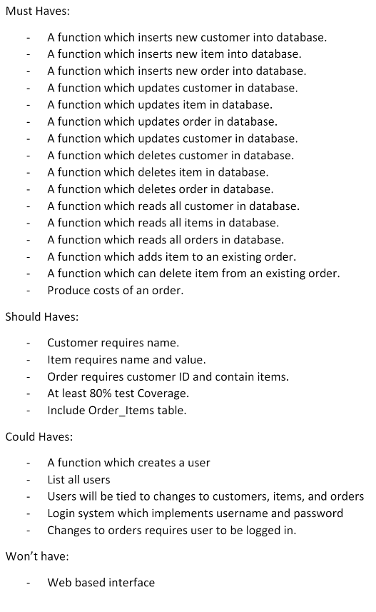
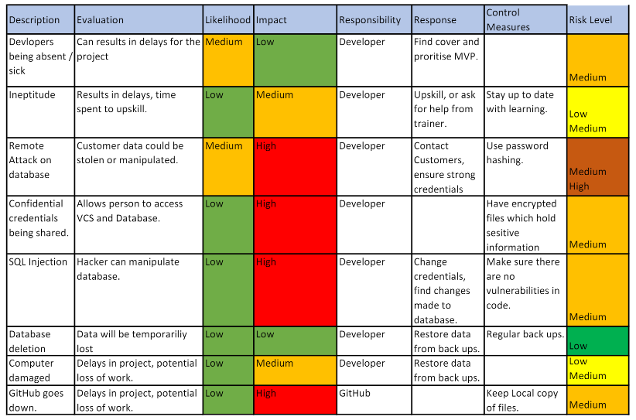
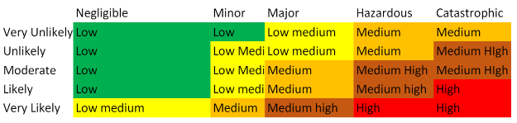
STAGE 1: MoSCoW and Risk Assessment

Slide 6
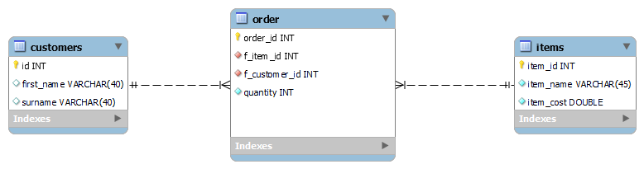
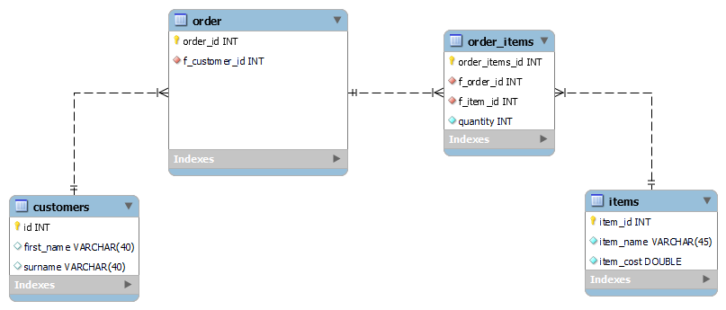
STAGE 1: ERD
INITIAL DESIGN:
FINAL DESIGN DESIGN:

Slide 7
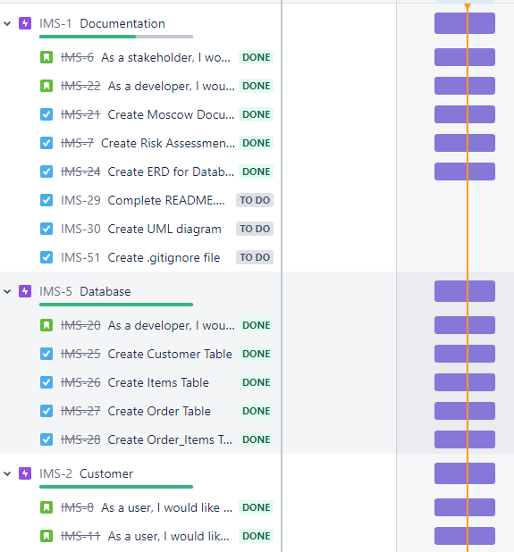
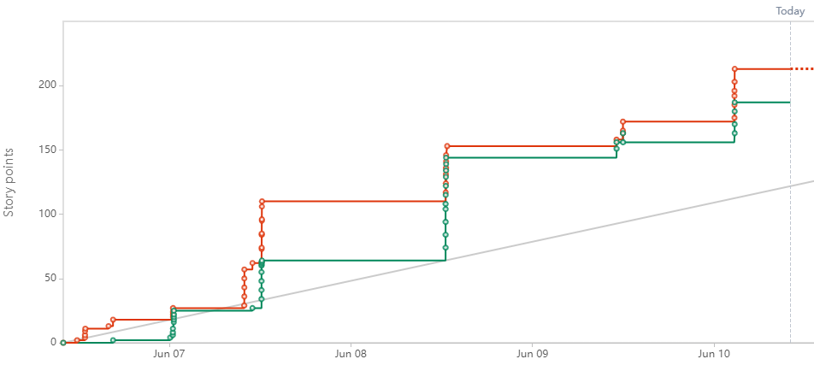
STAGE 1: JIRA

Slide 8
DATABASE
STAGE 2

Slide 9
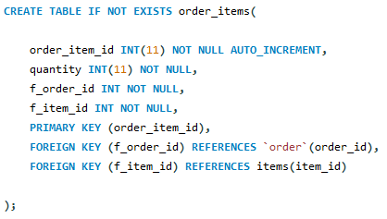

STAGE 2: CREATING TABLES
SQL Coding Example:
Started by creating tables for items,
Orders and Order-items in respective
Order.
After Completing I could move on to
The next stage.

Slide 10
JAVA
STAGE 3

Slide 11
STAGE 3: JAVA PLANNING
Classes and methods used for functionality are Split into 3 main packages: DOMAIN, DAO AND CONTROLLER
This is so that it conforms with SOLID PRINCIPLES
Classes that connects to the database and creates the menu etc. are also seperated

Slide 12
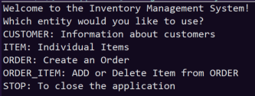

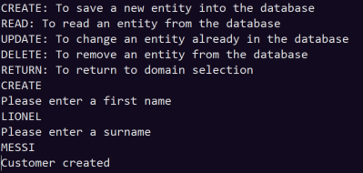
STAGE 3: CUSTOMER
UPDATE AND DELETE CAN BE DEMONSTRATED:

Slide 13
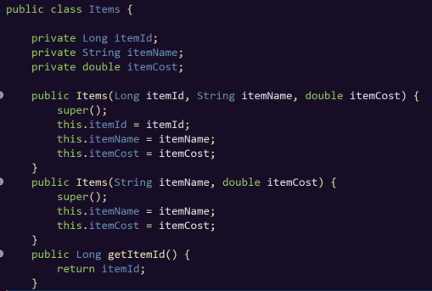
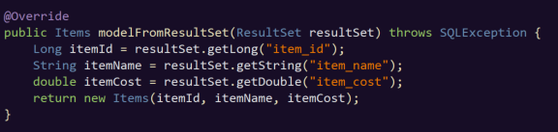
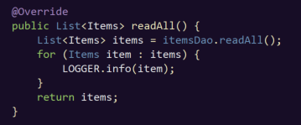
STAGE 3: ITEMS
DOMAIN, DAO AND CONTROLLER EXAMPLES:

Slide 14
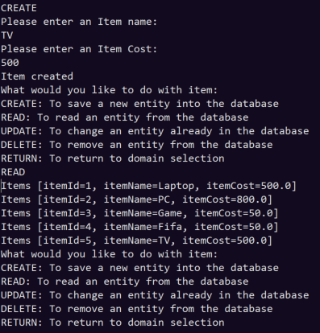
STAGE 3: ITEMS
UPDATE AND DELETE CAN BE DEMONSTRATED:

Slide 15
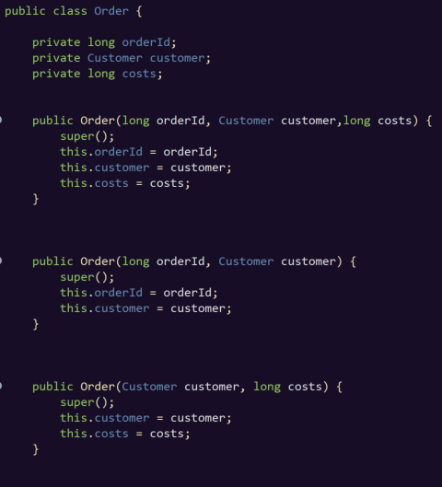
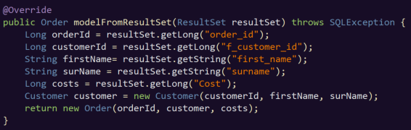
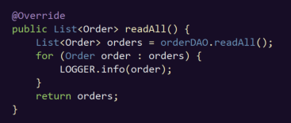
STAGE 3: ORDERs
DOMAIN, DAO AND CONTROLLER EXAMPLES:
Used Object Attributes in order to gather information which makes it easy for user to read and function.

Slide 16
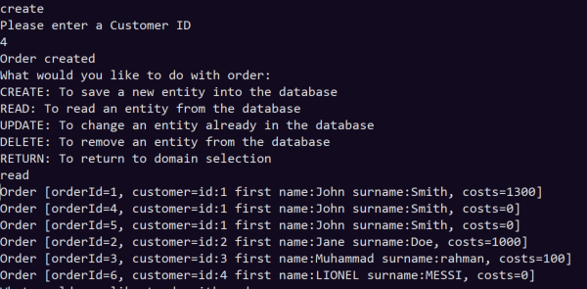
STAGE 3: ORDERs
ORDER includes Total Costs of Order,
Which automatically reads how many items and its
Costs a customer has purchased.
UPDATE AND DELETE CAN BE DEMONSTRATED:

Slide 17
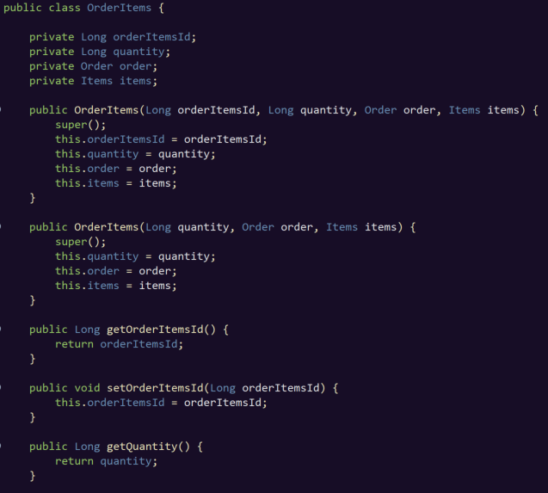
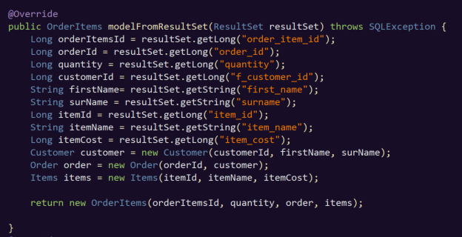
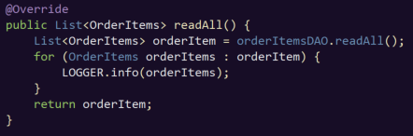
STAGE 3: ORDER-ITEMs
DOMAIN, DAO AND CONTROLLER EXAMPLES:

Slide 18
TESTING
STAGE 4

Slide 19
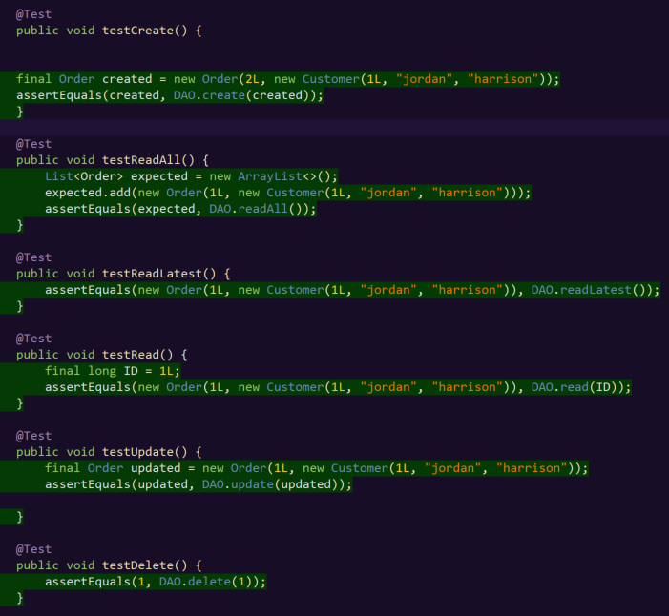
STAGE 4: JUnit
Here is an example of JUnit testing for OrderDAO class:
The tests ensure methods run as they should.

Slide 20
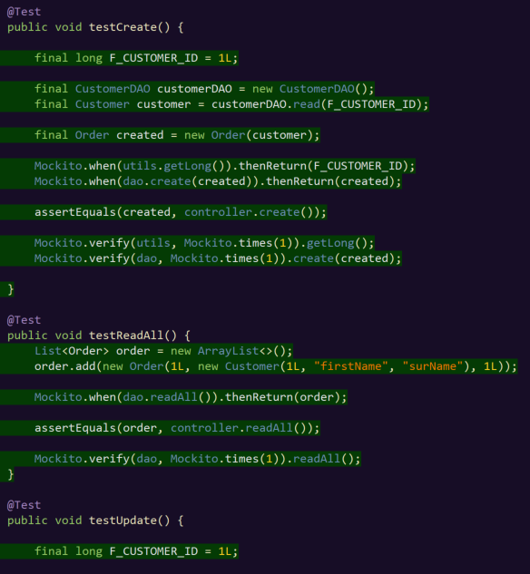
STAGE 4: MOCKITO
Mockito verifies the behavior of Controller under test without establishing connections first.
It is able to run SQL queries with a dummy database and data.

Slide 21
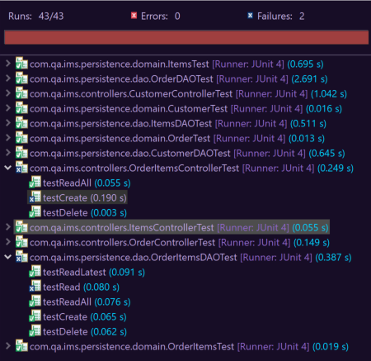
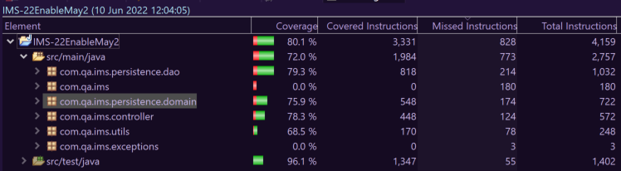
Stage 4: Testing – Current Coverage 80.1%

